Slide 1

Speech Enhancement Using U-Net with Compressed Sensing
Submitters:
Avihay Hadad
Elad Fisher
24-1-R-11
Supervisors:
Prof. Zeev Volkovich
Dr. Renata Avros

Slide 2
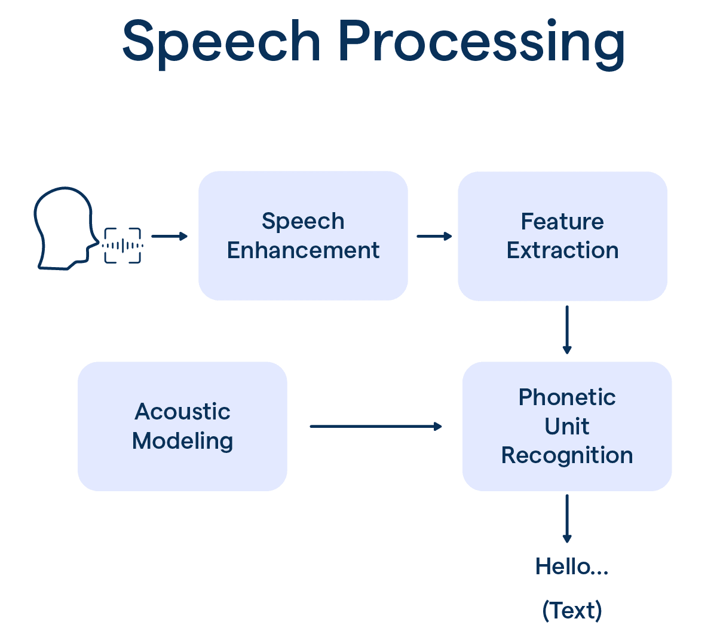
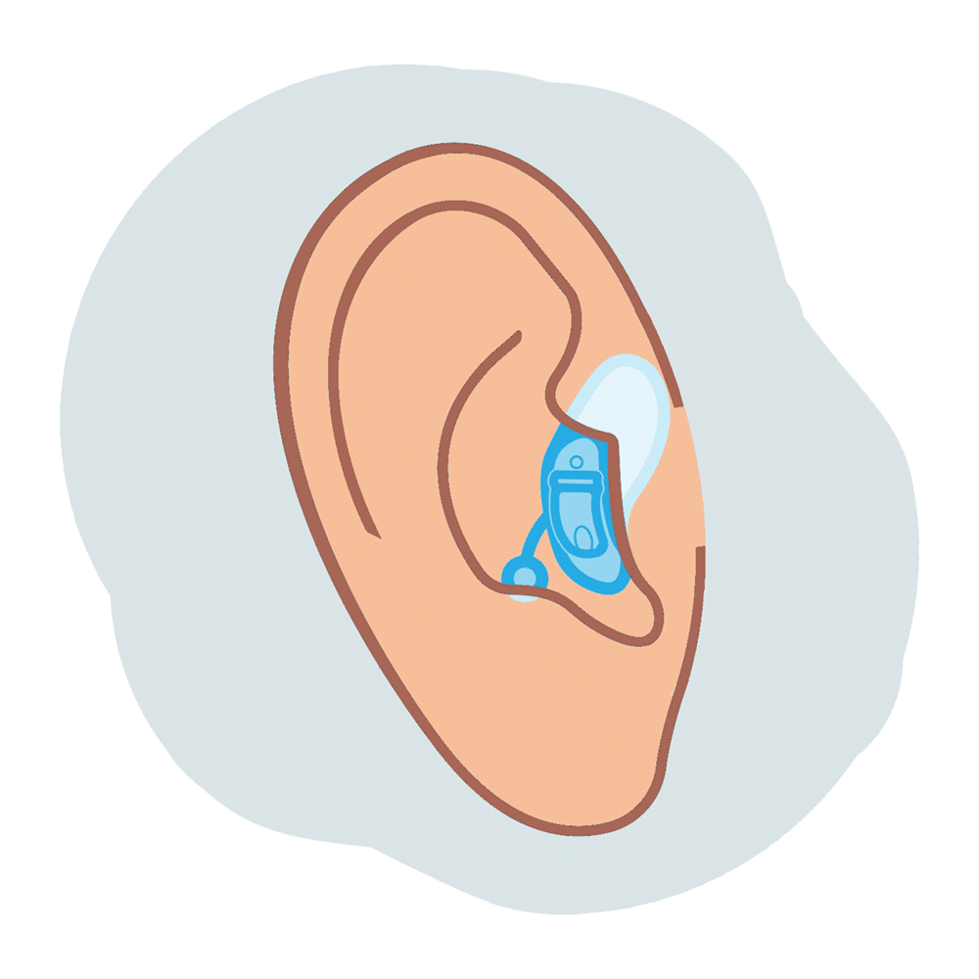

Speech Enhancement: Background
Speech enhancement is very important in the field of speech processing.
The goal is to improve the quality and intelligibility of speech which is disturbed by external noises.
Used in various applications:
Speech Recognition
Mobile Communications
Hearing Aids
- 1 -

Slide 3




Suggested Solution
A time-domain U-Net model combining lightweight Shuffle Attention mechanism and Compressed Sensing loss
The main idea is to use the architecture of U-Net to perform speech enhancement, while using CS loss to improve the quality and clarity of the enhanced speech.
+
Clean Speech
=
Noise
The Model
Noisy Speech
Enhanced Speech
- 2 -
Notes:
False Negative – I was wrong (false) when I said Negative

Slide 4
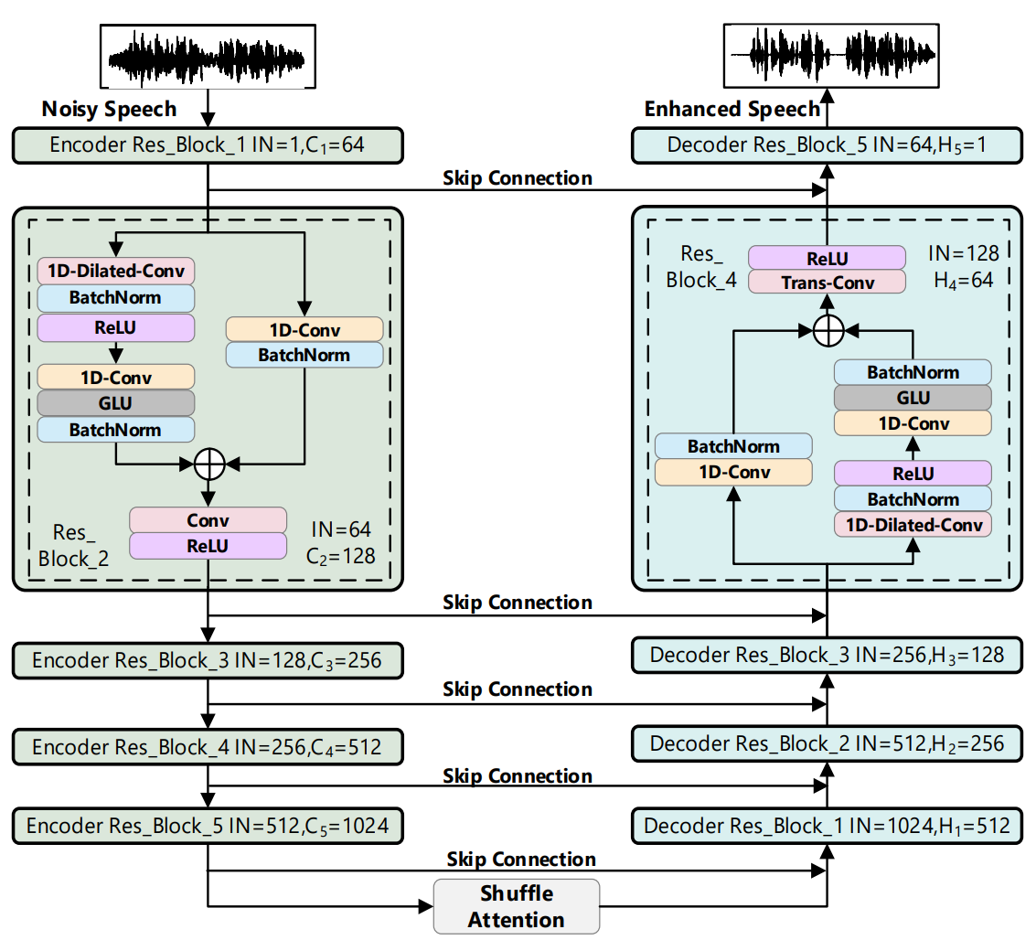
Model Workflow
+
Clean Speech
=
Noise
- 3 -

Slide 5
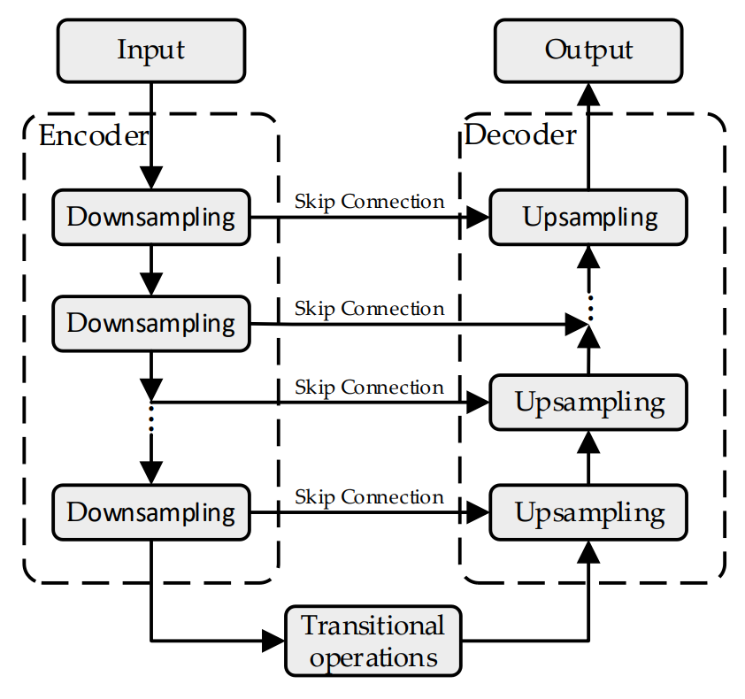
U-Net
A model that has equal number of layers in both encoder & decoder that uses convolutional blocks.
Pays attention to the speech contextual information and prevent the detailed features from being lost during down-sampling or up-sampling.
- 4 -

Slide 6
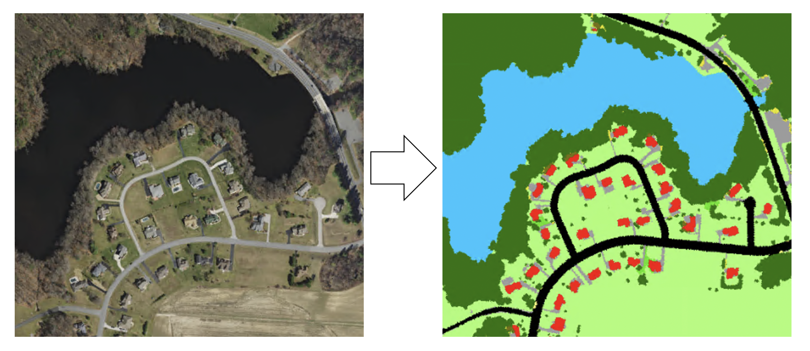
Time-Domain U-Net
In regular U-Net input typically consists of images (e.g., RGB images).
Time-Domain U-Net input: one-dimensional time series signal (e.g., audio waveform)
- 5 -

Slide 7
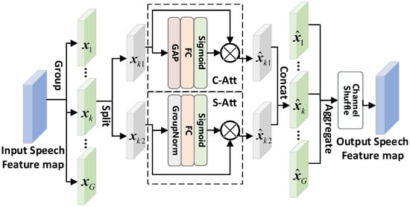
lightweight Shuffle Attention
Standard attention focuses on the important features, while lowering the weighted value of unwanted data.
Shuffle Attention focuses on both the relationships within each feature (Channel Attention), and the detailed features across spatial dimensions (Spatial Attention).
- 6 -

Slide 8
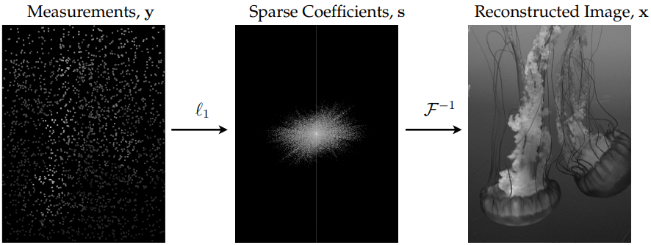
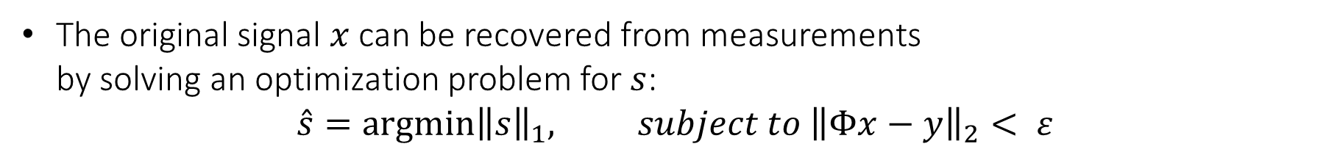
Compressed Sensing
The process of obtaining measurement signal $y∈ℝ^{M}$ is: $$y= Φx, (x= Ψs)$$
The original signal $x$ can be recovered from measurements by solving an optimization problem for $s$:
$$\hat{s}={argmin\left\|s\right\|}_{1}, subject to {\left\|Φx−y\right\|}_{2}< ε$$
- 7 -

Slide 9
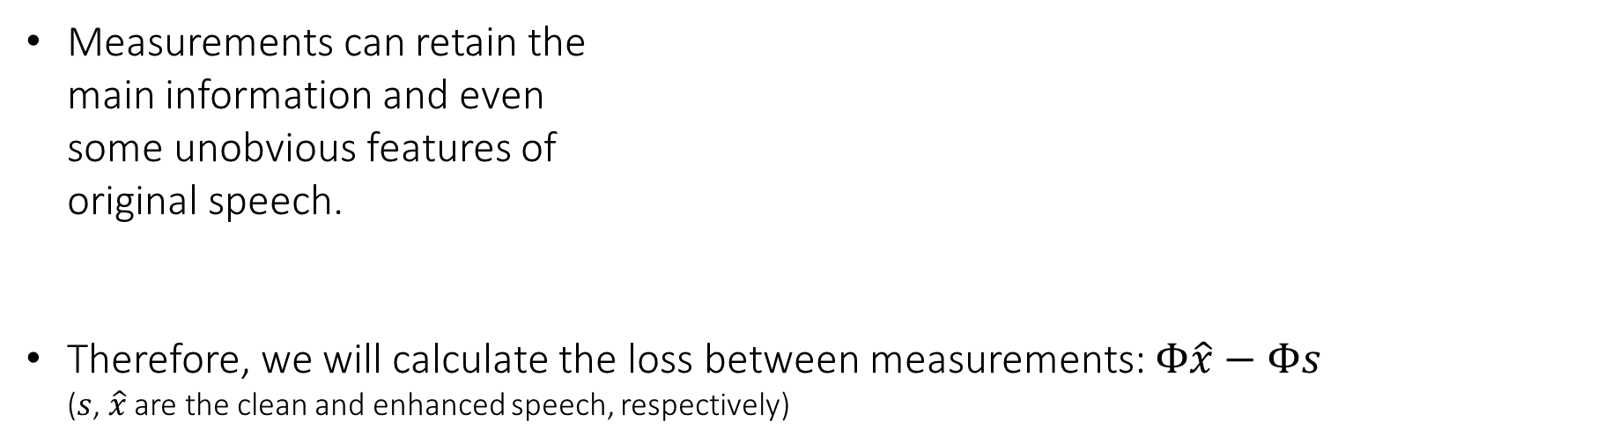
Compressed Sensing (Loss)
The process of obtaining measurement signal $y∈ℝ^{M}$ is: $$y= Φx, (x= Ψs)$$
Measurements can retain the main information and even some unobvious features of original speech.
Therefore, we will calculate the loss between measurements: $Φ\hat{x}−Φs$ ($s$, $\hat{x}$ are the clean and enhanced speech, respectively)
- 8 -

Slide 10
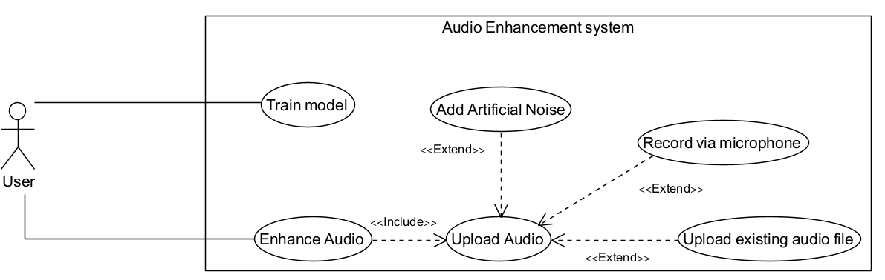
UML: Use Case
- 9 -

Slide 11
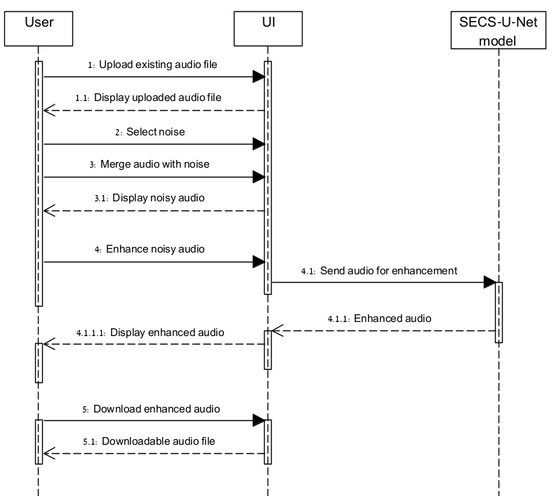
UML: Sequence
Successfully enhancing an uploaded audio file.
- 10 -

Slide 12
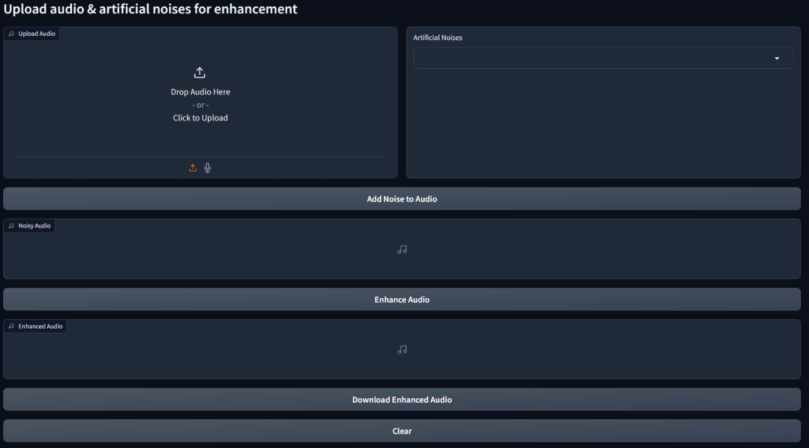

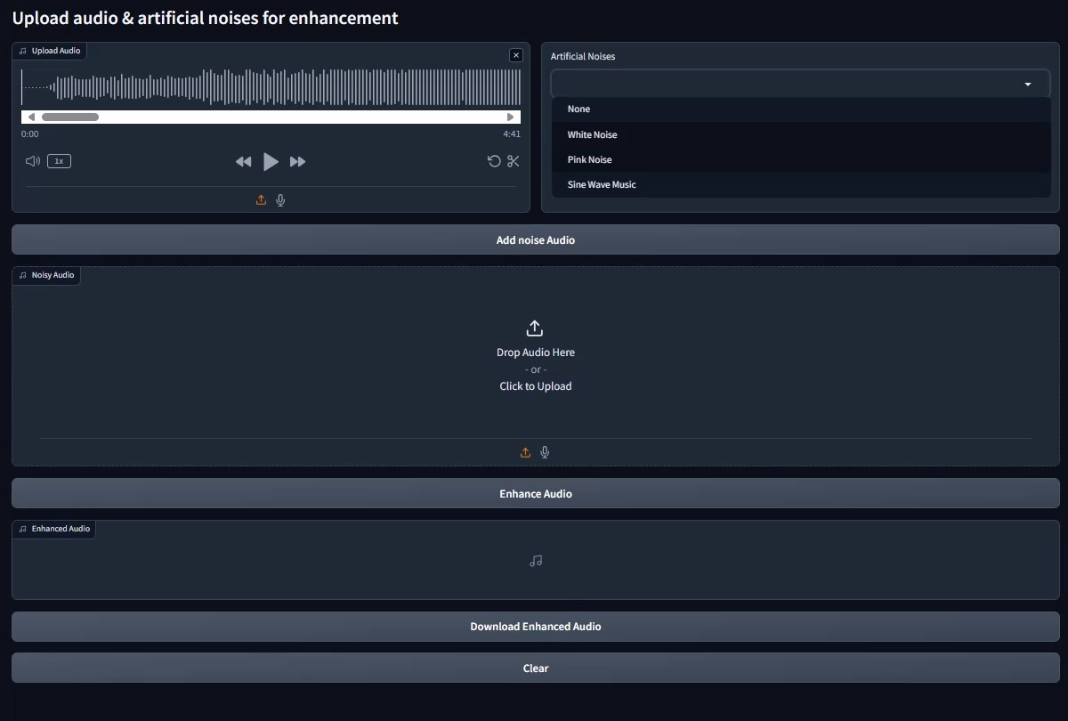
GUI – Main Screen
- 11 -

Slide 13
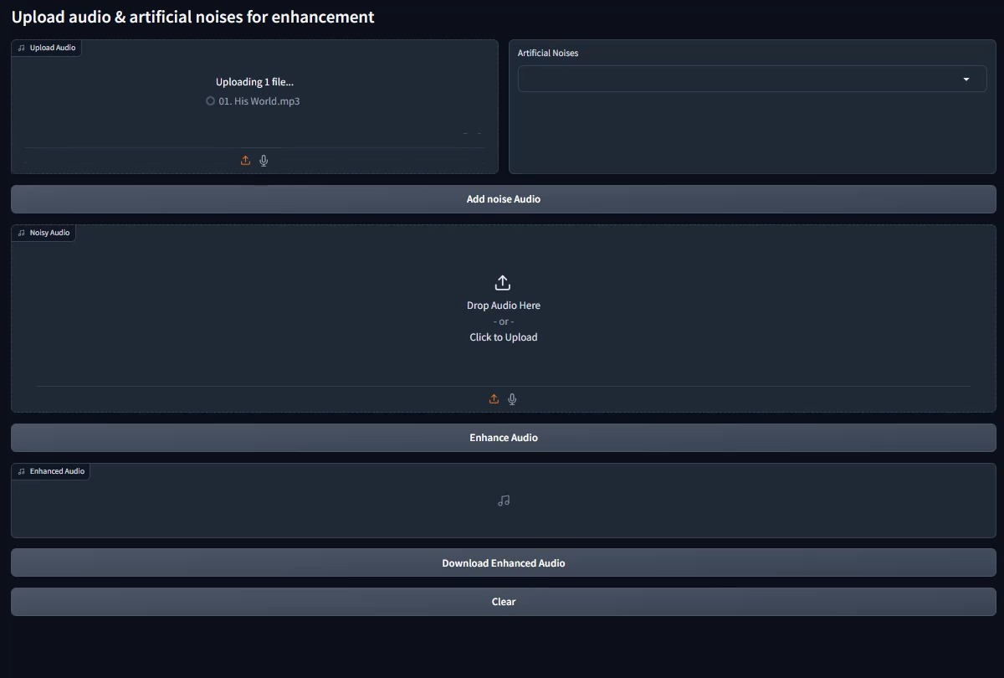
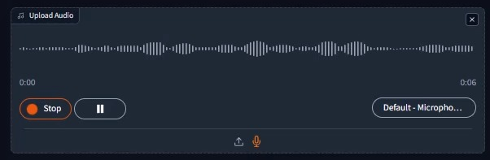
GUI – Uploading Audio
- 12 -

Slide 14
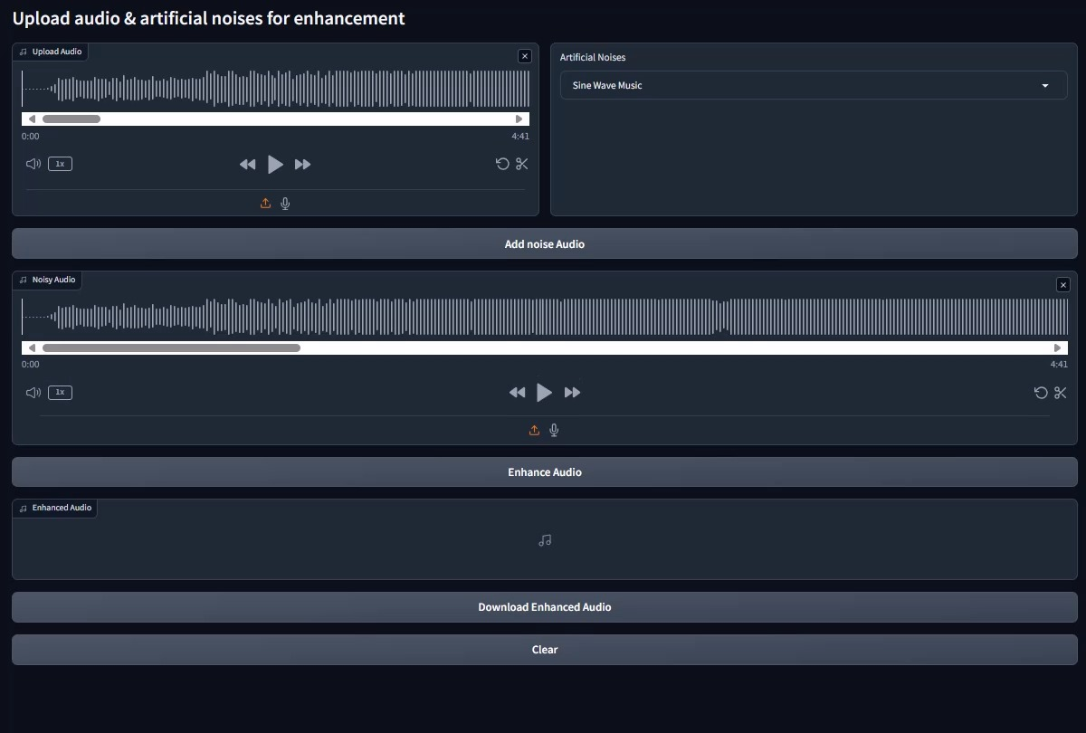
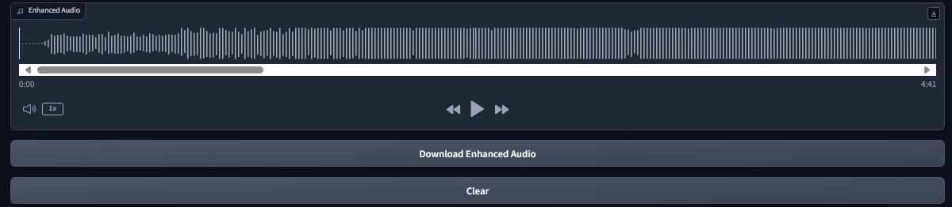
GUI – Enhancing Audio
- 13 -

Slide 15
Test Process
Test ID | Module | Description | Expected Result
1 | Home Page | Click "Enhance Audio" button, when the model has a trained data. | Opens "Enhance Audio" page.
2 | Enhance Audio Page -> upload audio box. | Clicking the "Click to Upload" button. | Opens window to select file.
3 | Enhance Audio Page -> upload audio box -> select file. | Selecting an audio file. | Closing the file select window, uploading the audio file.
4 | Enhance Audio Page -> Artificial Noises box. | Click Drop-down and selecting "Sine Wave Music". | Option "Sine Wave Music" should be chosen.
5 | Enhance Audio Page. | Clicking "Add Noise to Audio" button when both noise and audio are selected. | Starts merging the audio with the artificial noise.
6 | Enhance Audio Page. | Clicking " Enhance Audio " button when there is a noisy audio in the box. | Sends the noisy audio as input to the model to start the enhancement process.
7 | Enhance Audio Page. | Clicking "Download Enhanced Audio" when there is an audio in the "Enhanced Audio" box. | Opens a selection window to select download location for the file.
8 | Train / Enhance Audio Page | Click "Home" button. | Opens "Home" page.
- 14 -

Slide 16
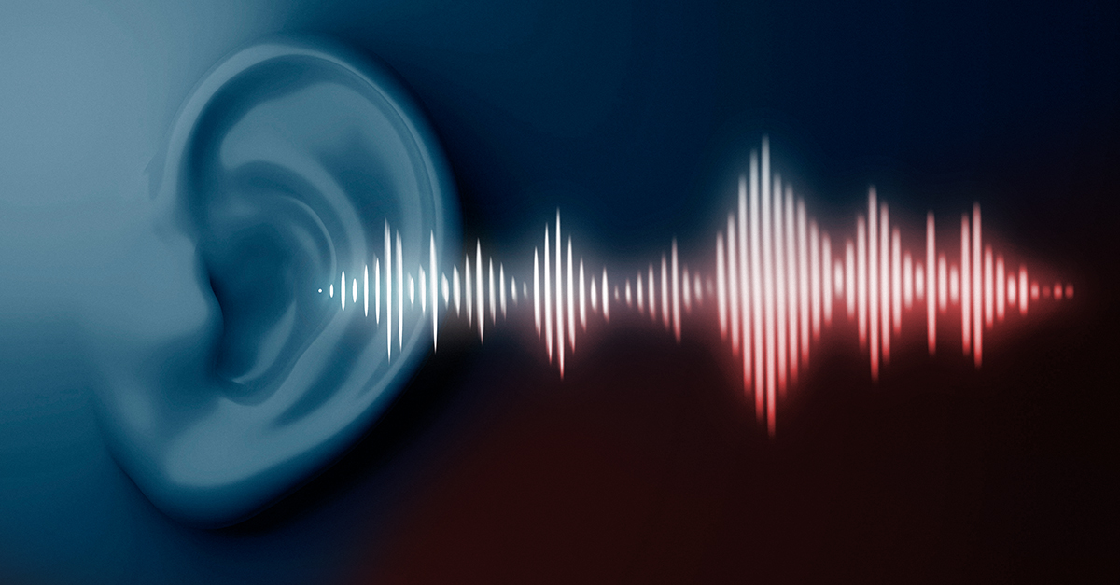
Thanks for your attention!
Elad Fisher
Avihay Hadad

